Slide 1




Amazon UK Products Dataset
Data Mining Project
Data Mining Project
Part of a
Data Mining – CMP7206
University Assessment

Slide 2


Hello!
Ashwani Kumar
Student, Birmingham City University
MSc. Big Data Analytics
Student ID: 23111092

Slide 3


Table of Contents
Introduction
Importance of Data Mining in E-Commerce
Literature Review
Case Study and Research Papers
Problem Statement
Dataset Description
Proposed Solutions
Methodology
Techniques
Impact
Conclusion
References
Ashwani Kumar/23111092

Slide 4
Introduction
Biggest e-commerce in the UK.
Vast range of product categories including Electronics, Clothing, Books, Household items, Beauty products and many more.
We are using Amazon UK dataset to get an in-depth insights and visualizations of what products sell best, what title structure best works for them, the best price range for a product category.
Ashwani Kumar/23111092

Slide 5
Importance of Data Mining in E-Commerce
Customer Understanding: Analyze customer behavior, preferences and trends. Helps in personalized marketing and product recommendations.
Predictive Analytics: Allows for forecasting customer demand, inventory management and pricing strategies based on historical sales data and trends.
Ashwani Kumar/23111092

Slide 6
Importance of Data Mining in E-Commerce
Optimizing Sales and Marketing Strategies: Analyzing data helps in optimizing marketing and sales campaigns, targeting specific audience and improving conversion rates.
Enhanced Customer Experience: By using Data Mining Techniques, e-commerce platforms can enhance the overall customer experience by offering customized recommendations and personalized experience.
Ashwani Kumar/23111092

Slide 7

Hello!
Dinesh Thapa
Student, Birmingham City University
MSc. Big Data Analytics
Student ID: 23206188

Slide 8
Literature Review
Author | Research Title | Data Mining Methods | Predictive Accuracy
Orieb Abu Alghanam, Sumaya N. Al-Khatib, Mohammad O. Hiari (Al-Ahliyya Amman University) | Data Mining Model for Predicting Customer Purchase Behavior in e-Commerce Context | K-Means, Classification by Decision Tree Induction, Apriori PT Association Rule Algorithm | 86.5%
Anurag Bejju (Birla Institute of Technology & Science) | Sales Analysis of E-Commerce Websites using Data Mining Techniques | Decision Trees (ID3 Algorithm) | 86.4789%
Jing Zhang, Juan Li | Retail Commodity Sale Forecast Model Based on Data Mining | Season Analysis Model, Markov Model | 79.1%, 79.7%
Yuan Chen, Feifei Wang | A Dynamic Pricing Model for E-Commerce Based on Data Mining | Association Rule Analysis, Cluster Analysis, Classification Analysis, Sequential Pattern Analysis | _
Dinesh Thapa/23206188

Slide 9
Case Study and Research Papers
Author | Research Title | Discussed Topics
Jon Kepa Gerrikagoitiaa, Iñigo Castandera, Fidel Rebóna, Aurkene Alzua-Sorzabal | New trends of Intelligent E-Marketing based on Web Mining for eshops | Discussion on Classification, Regression, Clustering, Affinity Analysis
Bei-Ni Yan, Tian-Shyug Lee, Tsung-Pei Lee | Analysis of research papers on E-commerce (2000–2013): based on a text mining approach | High frequency keywords, Density analysis, Centrality analysis, MDS analysis
David L. Banks, Yasmin H. Said | Data Mining in Electronic Commerce | Statistical Challenges and Opportunities in Electronic Commerce
Bhumika Pahwa, Dr. S. Taruna, Dr. Neeti Kasliwal | Role of Data mining in analyzing consumer’s online buying behavior | Data Mining and Consumer Behavior, Data Mining and Data Extraction
Note: These research papers has helped us a lot to think the same thing from different dimensions for the same thing.
They have contributed to our understanding of the topics in broad perspectives.
Dinesh Thapa/23206188

Slide 10

Hello!
Arun Rajput
Student, Birmingham City University
MSc. Big Data Analytics
Student ID: 22227184

Slide 11
Problem Statement
The objective of this Data Mining Project is to use the Amazon UK dataset
To extract valuable insights and data-driven decisions to enhance sales performance and customer satisfaction.
Identifying trending product categories, analyzing customer ratings for best/top seller products, and discovering niche categories for high sales.
Empowering Amazon UK to refine their marketing strategies and inventory management.
Arun Rajput/22227184

Slide 12
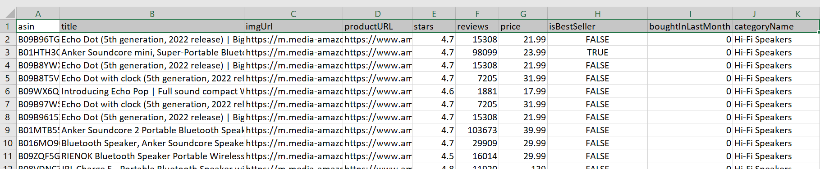
Dataset Description
Collection of products information from Amazon UK.
Data Primarily sourced from Amazon UK’s e-commerce platform.
We took this data from third-party platform Kaggle.com .
Variables Included in the Dataset
Fundamental attributes of products like ASIN (Amazon Standard Identification Number), Product Title, Image URL and prices.
Customer Centric variables such as ratings, reviews, sales status are also included.
Arun Rajput/22227184

Slide 13
Columns in our Dataset
Column Names | Meaning | Data Type
ASIN | Product ID from Amazon. Amazon Standard Identification Number. | str
Title | Title of the product. | str
imgURL | URL of the product image. | str
productURL | URL of the product. | str
stars | Product Rating, if 0, no ratings were found. | Float
reviews | Number of Reviews. If 0, no reviews were found. | int
price | Price of the product. If 0, Price was unavailable. | Type: Float, Currency: GBP
IsBestSeller | Whether the product had the Amazon Best Seller status or not. | Bool
boughtInLastMonth | Number of products sold last month according to Amazon. | Int
CategoryName | Name of the category this product belonged to. | Str
Arun Rajput/22227184

Slide 14
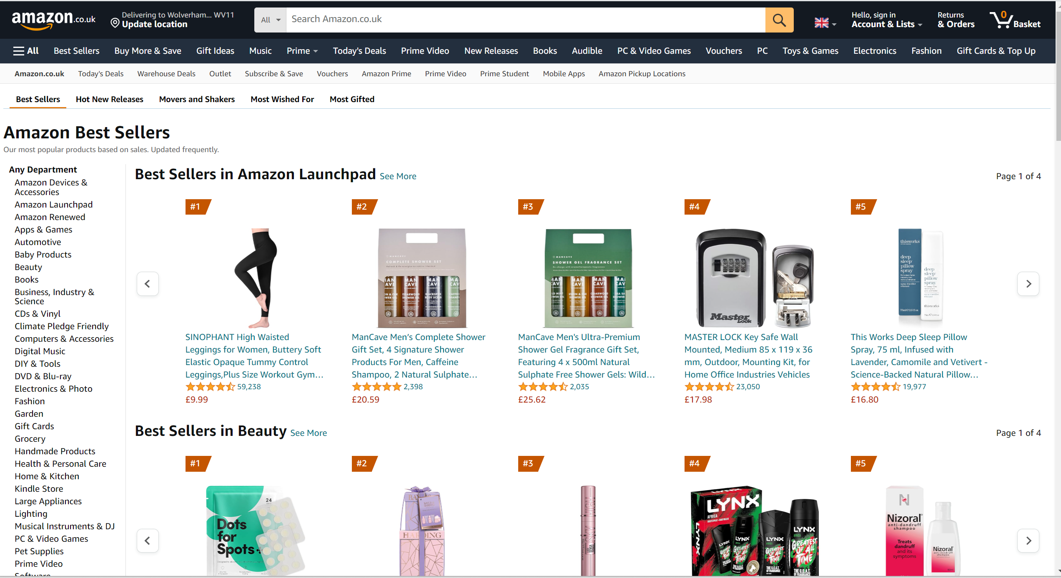
Proposed Solutions
1. Finding Trending Product Categories and Sales Performance
Analyzing sales data to identify which product categories are trending.
Visualize sales performance trends for different categories using time-series analysis.
Image Source:
https://www.amazon.co.uk/Best-Sellers/zgbs
Arun Rajput/22227184

Slide 15
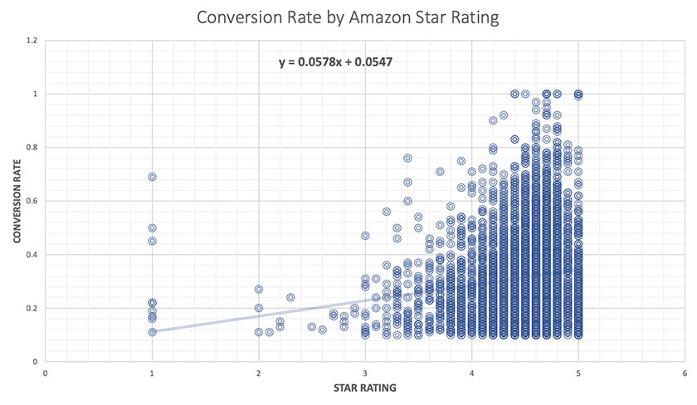
Cont’d…
2. Analyzing Customer Ratings for Best/Top Seller Products
Identifying products with the highest star ratings and analyzing their features.
Determining correlations between high ratings, number of reviews, and sales performance.
High rating correlate with high conversion/sales rate.
Image Source:
https://pattern.com/blog/analysis-high-amazon-star-rating-ups-conversion-sales-and-sessions/
Arun Rajput/22227184

Slide 16

Cont’d…
3. Identifying niche categories for high sales
Analyzing sales performance of different categories to identify niches with high potential for sales.
Determining which product categories have low competition and high sales.
Boosting Sales.
Image Source:
https://www.startupguys.net/wp-content/uploads/2019/12/sales-growth.jpg
Arun Rajput/22227184

Slide 17


Our Processes
Business Understanding
Data Cleaning
Data Understanding
Exploratory Analysis
Data Preparation
Predictive Modeling
Data Visualization
Data Modeling
Implementation
Evaluation
Evaluation
Deployment
Dinesh Thapa/23206188

Slide 18
Methodology
1. Data Understanding and Preparation
Loading the dataset into R and understand the structure, quality, and characteristics of the data.
Performing data cleaning, handle missing values, and preprocess data for analysis.
Exploring basic statistics and visualization to gain initial insights into the dataset.
1. Exploratory Data Analysis (EDA)
Conducting exploratory analysis to understand distributions, correlations, and patterns within data variables.
Visualize product categories, ratings, prices, and sales status to identify trends and potential relationships.
Using summary statistics and visualizations using histograms, box plots etc. to uncover insights.
Dinesh Thapa/23206188

Slide 19
Methodology
3. Trending Product Categories and Sales Performance
Applying Time-Series analysis to identify trending product categories.
4. Analyzing Customer Ratings for Best/Top Selling Products
Identifying top-rated products by analyzing ratings and reviews.
Using statistical methods to determine correlations between ratings, reviews, and sales performance.
4. Identifying Niche/Specific Categories for High Sales
Using clustering algorithms (K-means clustering) to group products into categories based on sales performance, prices and other respective variables.
Dinesh Thapa/23206188

Slide 20
Techniques
1. Time-Series Analysis
Implementing time-series forecasting models (ARIMA, PROPHET) to predict sales trends and identify trending product categories.
2. Correlation Analysis
Using correlation matrices and statistical tests (PEARSON CORRELATION) to measure relationships between variables like ratings, reviews, and sales.
3. Clustering Analysis
Applying Clustering techniques to segment products into categories based on various attributes like sales, ratings and reviews.
Dinesh Thapa/23206188

Slide 21
Techniques
4. Sentiment Analysis
Using sentiment analysis to analyze the customer sentiment towards products based on reviews and ratings.
5. Visualization Techniques
Creating informative visualizations like Bar charts, Scatter Plots, histograms, Box Plots to present findings and insights effectively based on their nature.
Dinesh Thapa/23206188

Slide 22

Impact
Providing insights for Amazon UK.
Sales Growth
Influence Customer Engagement
Market Competitiveness and Finding Unique advantage in the market.
Ashwani Kumar/23111092

Slide 23

Challenges & Improvements
Data Quality and Preprocessing
Challenge: Poor Quality Data and Incomplete Data.
Improvement: Implementing Preprocessing techniques
to ensure the input data is accurate, complete and suitable
for analysis.
Model Accuracy & Generalization
Challenge: Overfitting and Underfitting Data Mining Models may result in inaccurate predictions.
Improvement: Using Techniques such as Cross-Validation and ensemble methods to improve model accuracy.
Dinesh Thapa/23206188

Slide 24

Potential Improvements based on Literature
Integration of Sales Analysis and Forecasting
Combine sales analysis and forecasting techniques,
as suggested by Bejju (2016) and Zhang and Li (2016),
to provide a complete view of the e-commerce business
supporting them in better decision-making.
Application of Advanced Techniques
Applying the advanced data mining techniques mentioned in the literature, by Alghanam et al., Bejju, Zhang and Li, and Chen and Wang.
Dinesh Thapa/23206188

Slide 25
Conclusion
In the conclusion,
This project will help in identifying trending product categories, top-rated products and niche categories to grow the future sales.
This project will provide valuable insights for Amazon UK to refine marketing and sales strategy.
Boosting sales, improving customer engagement and enhancing customer satisfaction is the ultimate goal of this project based on the valuable data-driven decisions and insights.
Dinesh Thapa/23206188

Slide 26
“Information is the oil of the 21st century, and analytics is the combustion engine.”
- Peter Sondergaard
Senior Vice President and Global Head of Research at Gartner, Inc.
Dinesh Thapa/23206188

Slide 27
References
Harvard Referencing
Alghanam, O.A., Al-Khatib, S.N. and Hiari, M.O. (2022). Data Mining Model for Predicting Customer Purchase Behavior in E-Commerce Context. International Journal of Advanced Computer Science and Applications, 13(2). doi:https://doi.org/10.14569/ijacsa.2022.0130249.
Bejju, A. (2016). Sales Analysis of E-Commerce Websites using Data Mining Techniques. International Journal of Computer Applications, 133(5), pp.36–40. doi:https://doi.org/10.5120/ijca2016907812.
Zhang, J. and Li, J. (2016). Retail Commodity Sale Forecast Model Based on Data Mining. [online] IEEE Xplore. doi:https://doi.org/10.1109/INCoS.2016.42.
Chen, Y. and Wang, F. (2009). A Dynamic Pricing Model for E-commerce Based on Data Mining. 2009 Second International Symposium on Computational Intelligence and Design. doi:https://doi.org/10.1109/iscid.2009.99.
Dinesh Thapa/23206188

Slide 28
Thank you so much.
Truly Special Moment with you all.
For your time, attention, and thoughtful engagement.
Now, It’s Q&A Session.

